Slide 1

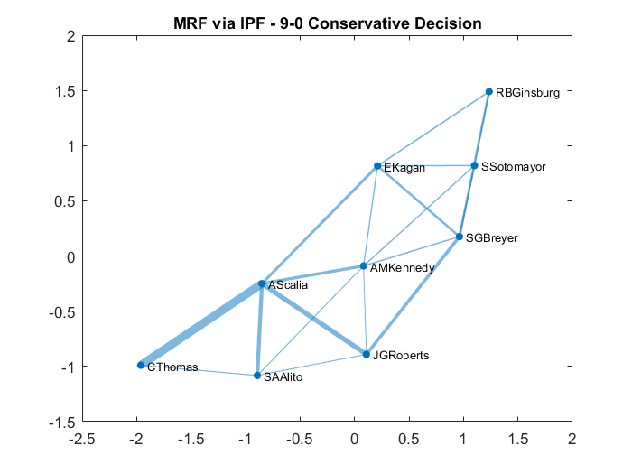
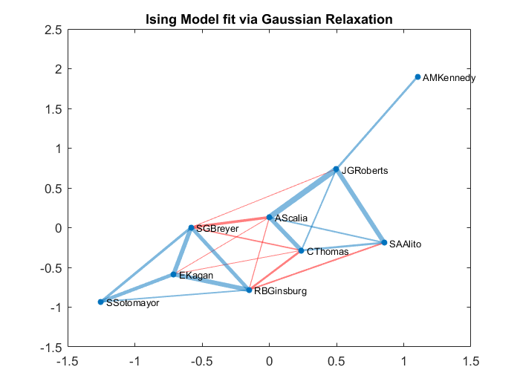
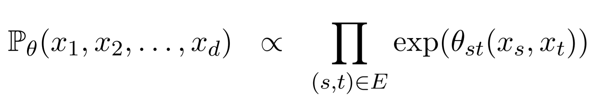
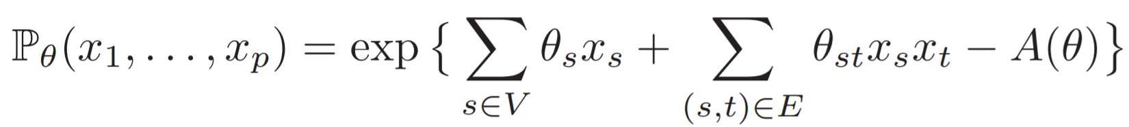
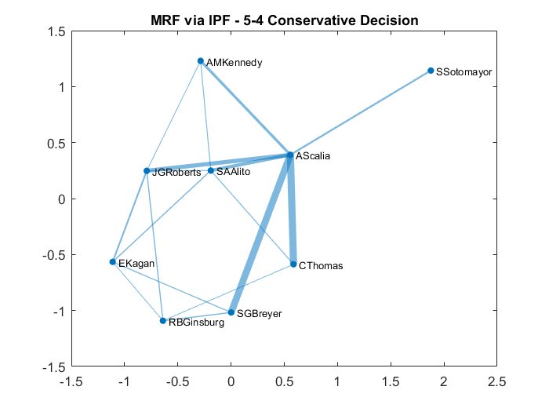
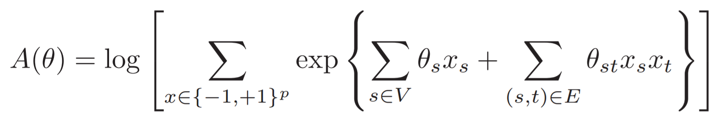
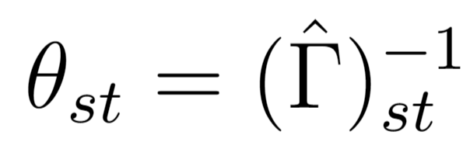
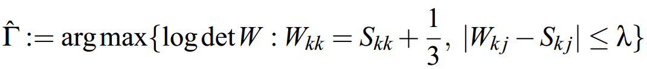
Erik P Bertelli, IEOR Department, UC Berkeley
The Supreme Court through Graphical Models
The Supreme Court of the United States is the nation’s highest court. Every year, they decide hundreds of cases with profound implications for our constitutional system by majority vote of the nine justices on the court. Using the six most recent complete terms from 2010-2015, I have constructed a number of graphical models to approximate the relationships among the justices. I find that these models generally reach the expected conclusion, that the five Republican appointed justices and four Democrat appointees tend to vote together.
Data
The Supreme Court Database at Washington University in St. Louis records every Supreme Court decision over the past half century. There are 343 cases during the 2011-2015 terms with votes for all nine justices. For each justice, they encode whether their opinion was in a conservative (1) or liberal (2) direction that I will then convert to binary or spin variables.
IPF Model – 9-0 Conservative Decision
Most cases are decided by a unanimous decision of the court. This is a graphical representation of a 9-0 Conservative Decision. Edges with parameter θ < 0.1 are hidden while the remaining edge weights are proportional to their parameter values.
Ising Model – Fit via Gaussian Relaxation
Using the code provided by Banerjee et at. [2008], I computed the estimated precision matrix Γ based on the Gaussian Relaxation of the MLE. However, I suspect the large number of unanimous decision swamped the correlations, so I excluded them and was left with 175 split decisions. I then hid the edges with very small parameters (in absolute terms). To display the graph, I will once again make the edge weights proportional to the θ value, but this time color the negative edges red.
As you can see, the two Conservative and Liberal cliques are obvious in this graphical model. Interestingly, Kennedy has degree one, as his row in the estimated precision matrix had only one entry (Roberts). This makes sense, given that his reputation as a “swing vote” would give him lower correlation with the other justices.
Pairwise Markov Random Field - IPF
A simple model of the justices’ interaction is a Pairwise Markov Random Field which can be solved via Iterative Proportional Fitting:
To create this model, I will assume a complete graph and then threshold the θ values to enforce sparsity. The largest θ values are the most important in determining the probability of that particular voting coalition.
Ising Model – Graph Selection via MLE
The graph can also be determined algorithmically. Using a MLE estimate with a ℓ-1 penalty, we can estimate the parameters θ.
The problem with this approach is that the normalization function A(θ) is difficult to optimize:
Therefore I will use the Gaussian approximation used in Banerjee et al. [2008] first proposed by Wainwright and Jordan [2006]. In this approximation the edge weights θ are given by:
Where Γ is the estimated precision matrix based on the maximization of the log determinant of the modified sample covariance S:
IPF Model – 5-4 Conservative Decision
A more contentious and high profile case will often end in a 5-4 split, with the conservative appointees outnumbering the liberal justices to decide the case. Here is a representation of such a case:
References
Harold J. Spaeth, Lee Epstein, et al. 2016 Supreme Court Database, Version 2016 Release 1. URL: http://Supremecourtdatabase.org
O. Banerjee, L. El Ghaoui, A. d'Aspremont, Model Selection Through Sparse Maximum Likelihood Estimation. Journal of Machine Learning Research, 9, pp. 485-516, March 2008.
M. Wainwright and M. Jordan. Log-determinant relaxation for approximate inference in discrete markov random fields. IEEE Transactions on Signal Processing, 2006.

